Slide 1
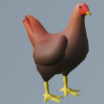
Cluck Quest
Take back your eggs and avoid getting eaten!

Slide 2

About
Audience: All ages and skill sets
Genre: 3-D Platformer

Slide 3
Synopsis
Theme
Aesthetic: 3-D Low-poly, colorful and playful
Ideology: Perseverance, exploration
Goals
Parkour your way through platforms to the end of each level
Collect all eggs in each level
Avoid obstacles and enemies
Uniqueness
You are a chicken doing parkour!

Slide 4
Mechanics
Use speed and mobility to run and jump onto platforms, progressing forward in a linear level
Reaching the end of a level will teleport you to the next one
Obstacles will inhibit your movement
Making contact with enemies will reset your level progress
The more eggs you collect, the higher your score

Slide 5
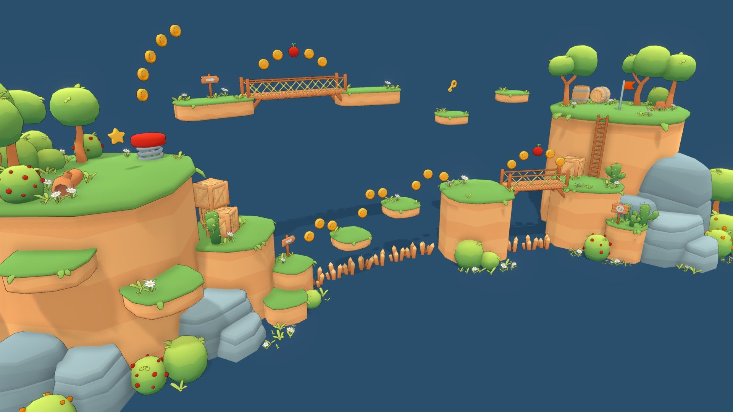
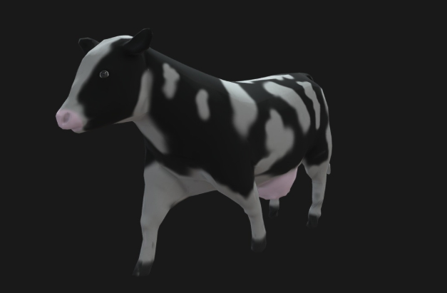
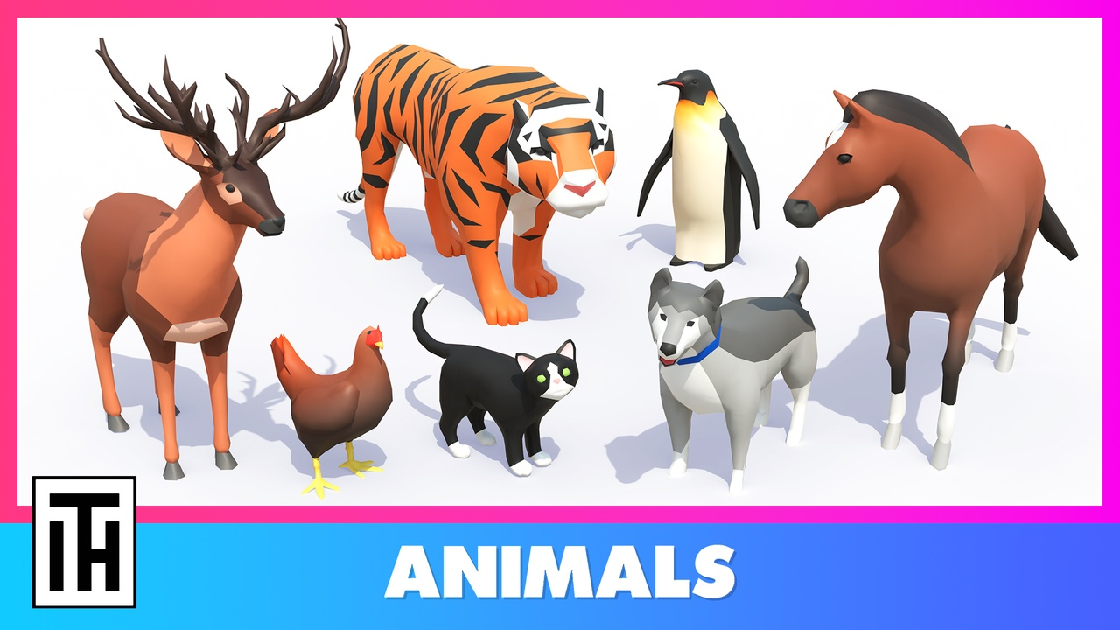

Images – Assets from Fab and Inspo

Slide 6
Completed Progress

Slide 7
To-Do

